Slide 1
Team Software Process
MIEIC: ESOF
Class 1 – Group F
Diogo Peixoto Pereira – up201504326
Maria Eduarda Santos Cunha – up201506524
Pedro Miguel Ferraz Nogueira da Silva – up201505460

Slide 2

Team Software Process
Team Software Process (TSP) is a software development strategy developed in 1996 by Watts Humphrey.
Watts Humphrey

Slide 3
Team Software Process
TSP is a software development strategy that provides a well defined process framework designed to:
show managers and engineers how to build self-directed teams
plan and manage their work
coach and motivate their teams
sustain peak performance
produce software products in a way that improves the quality and productivity of the team

Slide 4
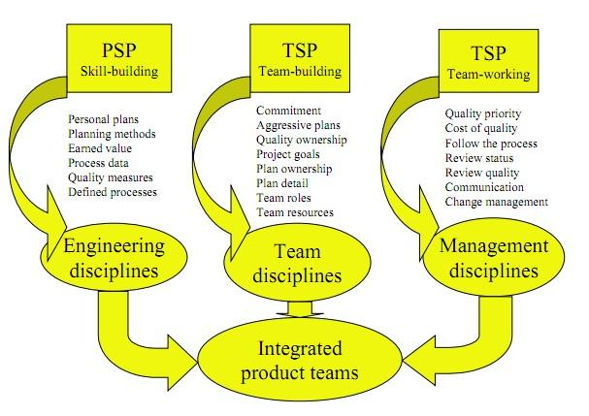
Team Software Process
To really understand TSP, engineers must be trained in the Personal Software Process (PSP), in which they learn how to gather and use process data, make detailed plans, manage product quality as well as using earned value to find a project. The main elements of TSP can be summarize in this figure:
TSP main elements

Slide 5
Team Software Process
TSP divides the team in various roles with specific functions:
Team leader
Team coach
Quality manager
Planning manager
Design manager
Support manager
Implementation manager
Test manager

Slide 6
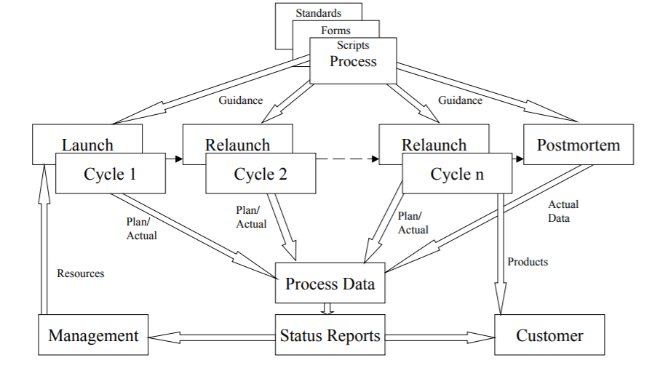
Team Software Process
The TSP consists of six major phases:
Launch
Requirements
High Level design
Implementation
Release Test
Post Mortem
TSP Process Flow

Slide 7
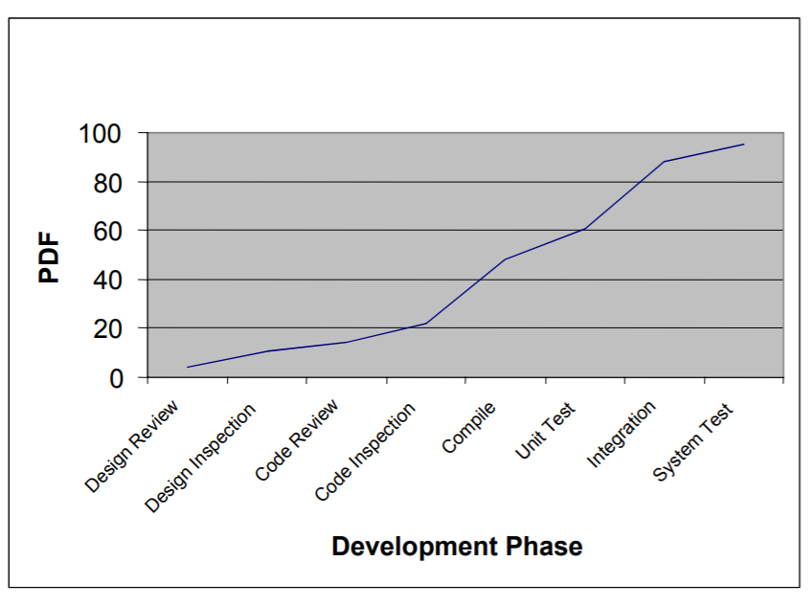
Team Software Process
The quality of a project is an essential part of it. The TSP shows teams how to manage quality, by doing:
Quality Plan
Identifying Quality Problems, using:
Prevent Quality problems
Percent defect Free (PDF)
Defect-removal profile
Quality profile
Process quality index (PQI)
PDF plot

Slide 8
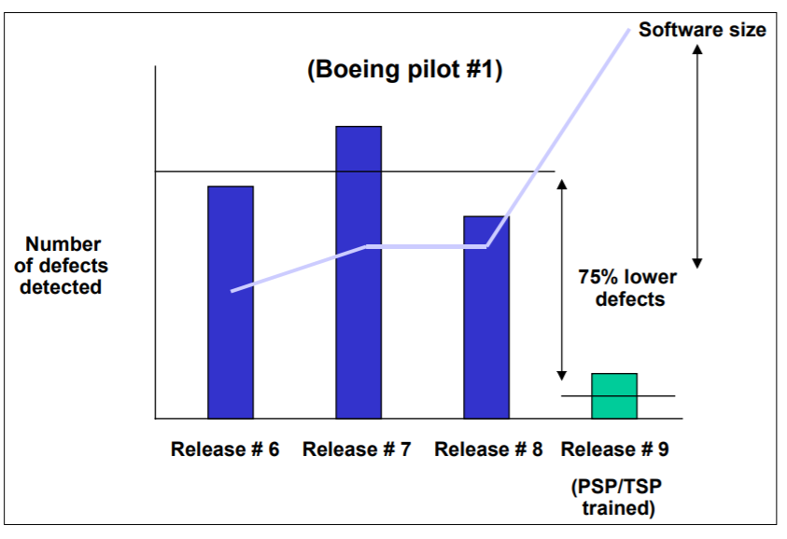
Team Software Process
TSP is being introduced into both industrial and academic environments. Some examples of projects where TSP was successfully used can be seen here:
Teradyne
Hill Air Force Base
NedBank
Beckman Coulter
Boeing
TSP Test Defects

Slide 9
Team Software Process
TSP has many proven benefits…
Improved size, effort and schedule estimation
Improved productivity
Better defect detection
High quality products
…but also some cons:
Need to do a lot of plans that have to be strictly followed
Wastes a lot of time in weekly meetings
Lot of thinking before the actual work
Constant management’s pressure to team members

Slide 10
Team Software Process
Without a doubt, TSP is a software development strategy that differentiates from others because of the main role a team has in the software development. More than focusing on the individual, TSP forms a strong team with well defined roles, in order to produce the best software possible for the clients it attends.

